Slide 2
The program is designed to provide pathways for the continuum of learners at Northeast High School that are interested in food, energy, water, and societal systems (FEWS2).
Examples include:
Students who plan to enter the workforce after high school graduation can earn non-credit competencies in certain areas that will give them an edge as they look for employment.
Students will be able to earn college credit for classes that will transfer to University of Nebraska and other post-secondary institutions.
Students who earn a certain number of focused, college-level credits can earn a certificate designed to support work after high school or a start towards a four-year degree.
Students will be able to explore careers in the growing areas of FEWS2 through experiential learning and academic and career advising.
Food, Energy, Water, and Societal Systems (FEWS2)

Slide 4
Pathways – Serving the Continuum of Learners
Pre-pathway (9-10):
FEWS² concepts/models with design thinking and futures thinking embedding into existing LPS courses at Northeast
Math
Science
Social Studies
CTE
Hands-on immersive experiences and short-term, on-campus experiences
Early College and Career Pathway (11-12)
Accelerated - College credit/certificate; experiential learning; academic advising and mentoring; career exploration
On-track – College credit / digital badge; experiential learning; academic advising and mentoring; career exploration
Career interest in FEWS2 – digital badge; experiential learning; career exploration
No intent to pursue post-sec education
Internship opportunities
Food, Energy, Water, and Societal Systems (FEWS2)

Slide 5
Timeline
Program | Target Audience | Launch Date
Co-creation phase |  | Spring 2021
Summer Enrichment Program | Middle School Students | Summer 2021
FEWS² concepts and models integration Northeast HS curricula | 9th and 10th Grade Students | Fall 2021
Hands-on immersive experiences and short-term, on-campus experiences | 9th and 10th Grade Students | Fall 2021
Nebraska Now | 11th and 12th Grade Students | Fall 2022
Non-credit pathways | 11th and 12th Grade Students | Fall 2022
Food, Energy, Water, and Societal Systems (FEWS2)

Slide 6
Opportunities to Engage
Summer enrichment program
Content expert to partner with Northeast Education Team to integrate FEWS2 concepts into 9th- and 10th-grade courses
Offer hands-on immersive experiences and short-term, on-campus experiences for 9th and 10th grade students
Nebraska Now and digital badges
Experiential learning for 11th and 12th grade students
Food, Energy, Water, and Societal Systems (FEWS2)

Slide 7
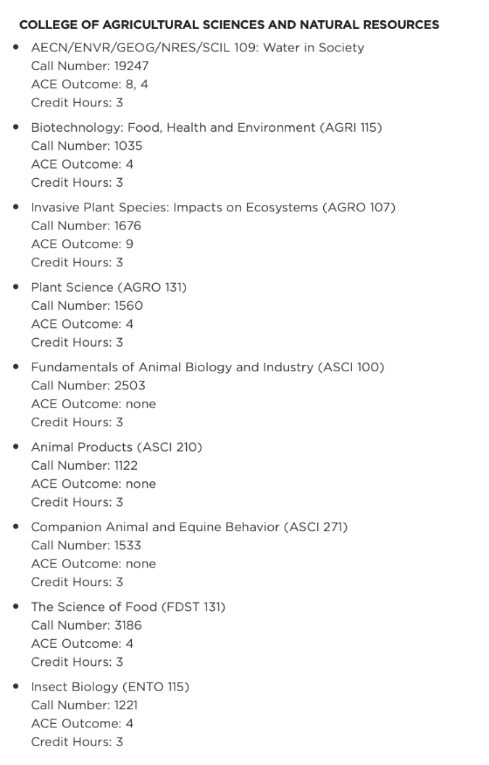
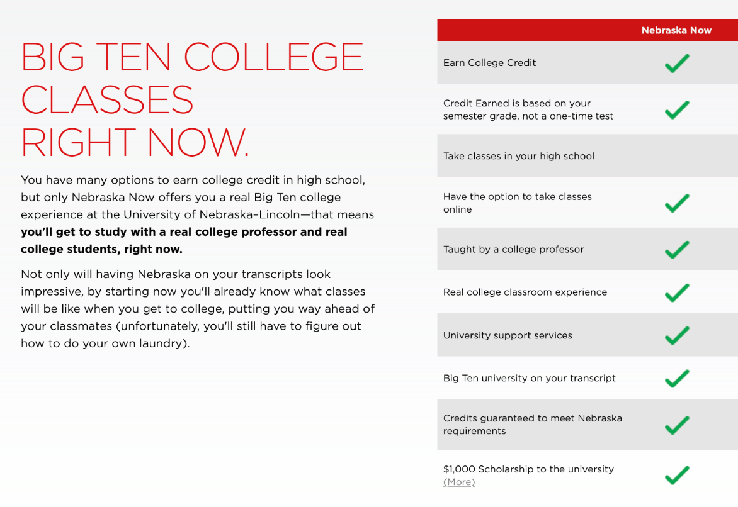
Food, Energy, Water, and Societal Systems (FEWS2)

Slide 8
Opportunities to Engage
Summer enrichment program
Content expert to partner with Northeast Education Team to integrate FEWS2 concepts into 9th- and 10th-grade courses
Offer hands-on immersive experiences and short-term, on-campus experiences for 9th and 10th grade students
Nebraska Now and digital badges
Experiential learning for 11th and 12th grade students
Food, Energy, Water, and Societal Systems (FEWS2)

Slide 9
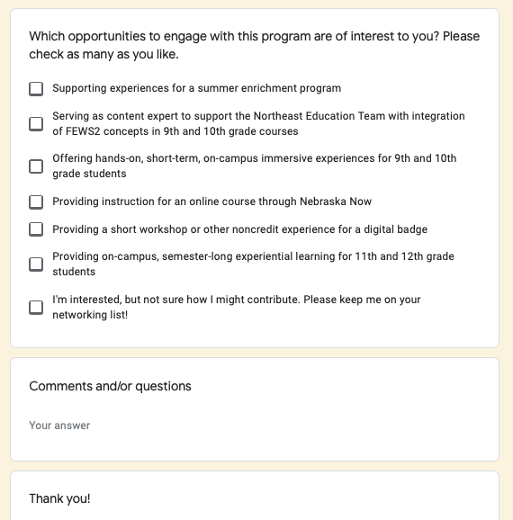
https://docs.google.com/forms/d/e/1FAIpQLSeNNJ-b5LmK3PUuN77FZlWSIHBLijThp5tnvYcHeJxHnWM8vA/viewform
Food, Energy, Water, and Societal Systems (FEWS2)

Slide 10
Questions
Food, Energy, Water, and Societal Systems (FEWS2)

Slide 11
Additional Information
Website: https://casnr.unl.edu/early-college-and-career-stem-program
Videos:
https://youtu.be/BZBdiGykXd0
https://www.youtube.com/watch?v=NKDy_kbjLRM
CASNR Contacts:
Erin Ingram: Summer Enrichment Programs
Sue Ellen Pegg: Summer Enrichment Campus Visits
Larkin Powell
Tiffany Heng-Moss
Food, Energy, Water, and Societal Systems (FEWS2)

