Slide 1
In Nebraska.
Impacting the world.
Science will be the key that unlocks the world’s next great challenges and our college focuses on science with a purpose, solving problems of our shared future. Problem solving is holistic in approach and creates society-ready graduates that have the confidence, innovation, and competence to embrace the great challenges and make a difference in impacting the world.
Annual Faculty Meeting: August 21, 2014

Slide 2
A year in review ….
Highlights from 2013-2014

Slide 3
Numbers: 2013-2014 Academic Year
Enrollment:
  9 years of growth: highest enrollment
  UG: 2,114 GD: 641 Professional Students: 64
Retention Rate: 90% CASNR, 72% national average
Graduation Rate: ~78%, highest at UNL
Placement rate: highest entry placement rate at UNL
Possible because of the commitment among our faculty and staff to recruitment, retention, and placement

Slide 4
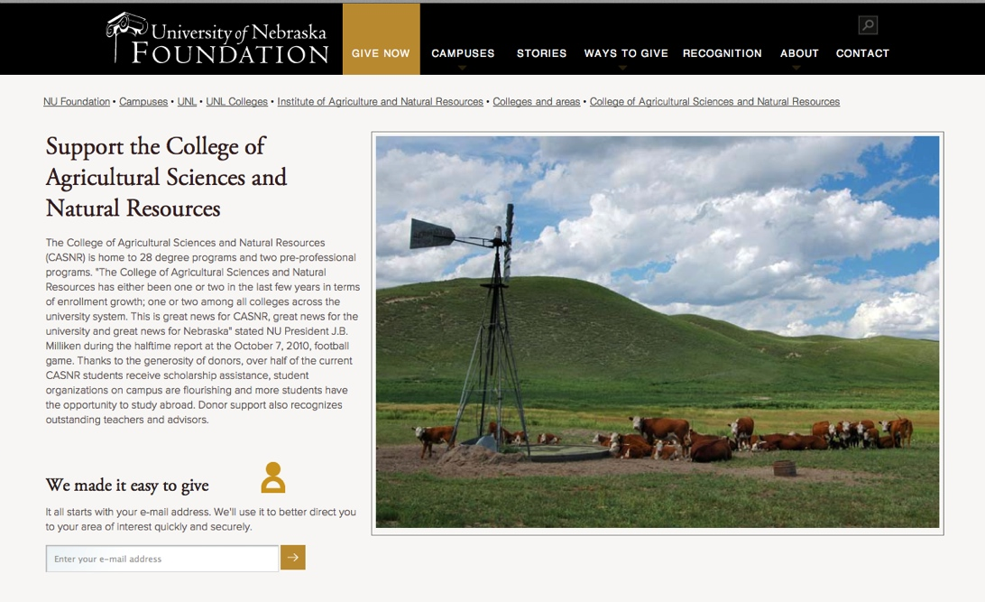
CASNR Scholarships
Number of scholarships awarded by CASNR: 991
Percent of students receiving scholarships: 39.1%
Total amount awarded: $1,095,724

Slide 5
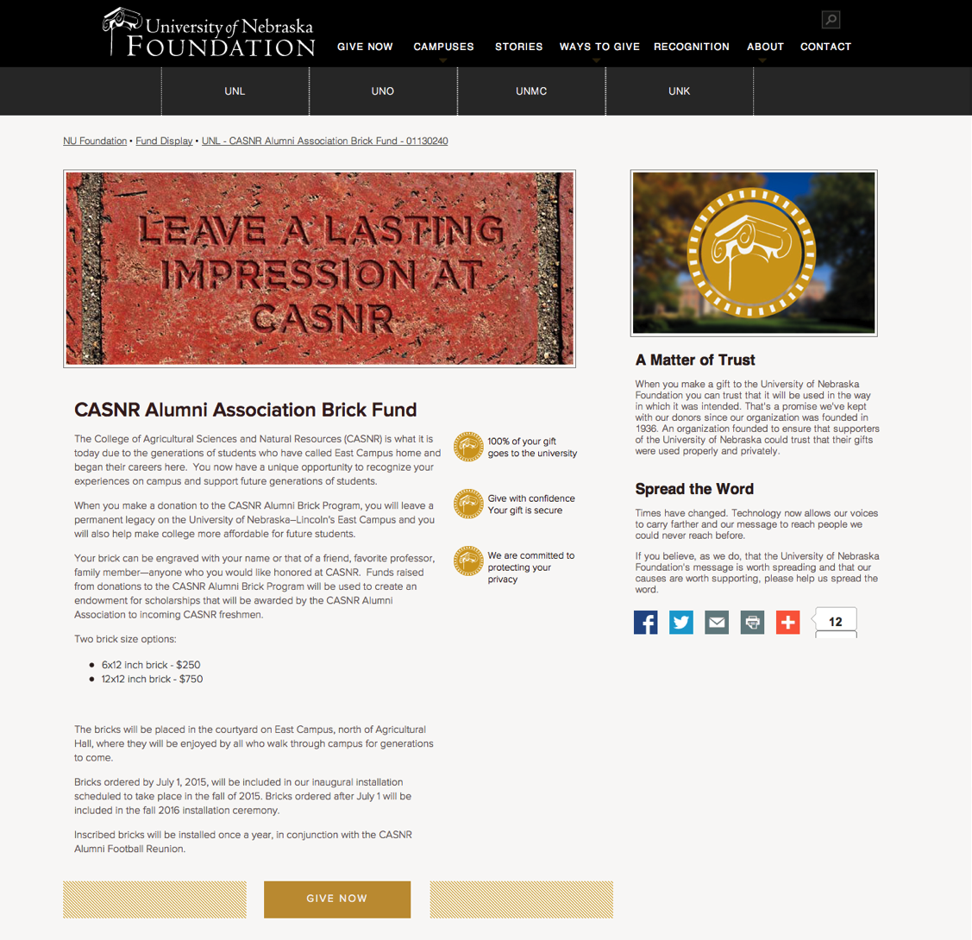
CASNR Scholarships
CASNR Alumni Brick Program – opportunity to leave a permanent legacy
Funds will be used to create an endowment for scholarships

Slide 6
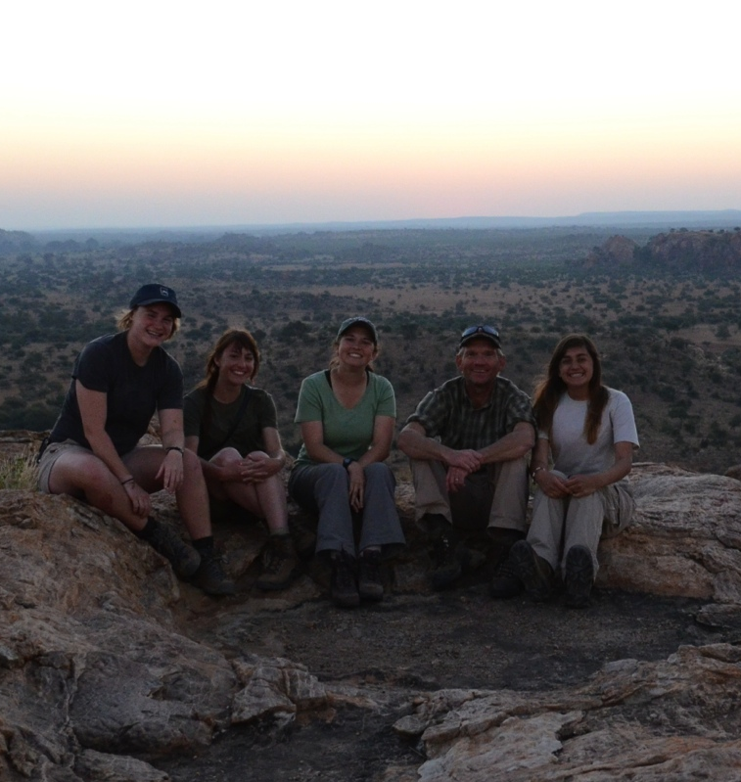

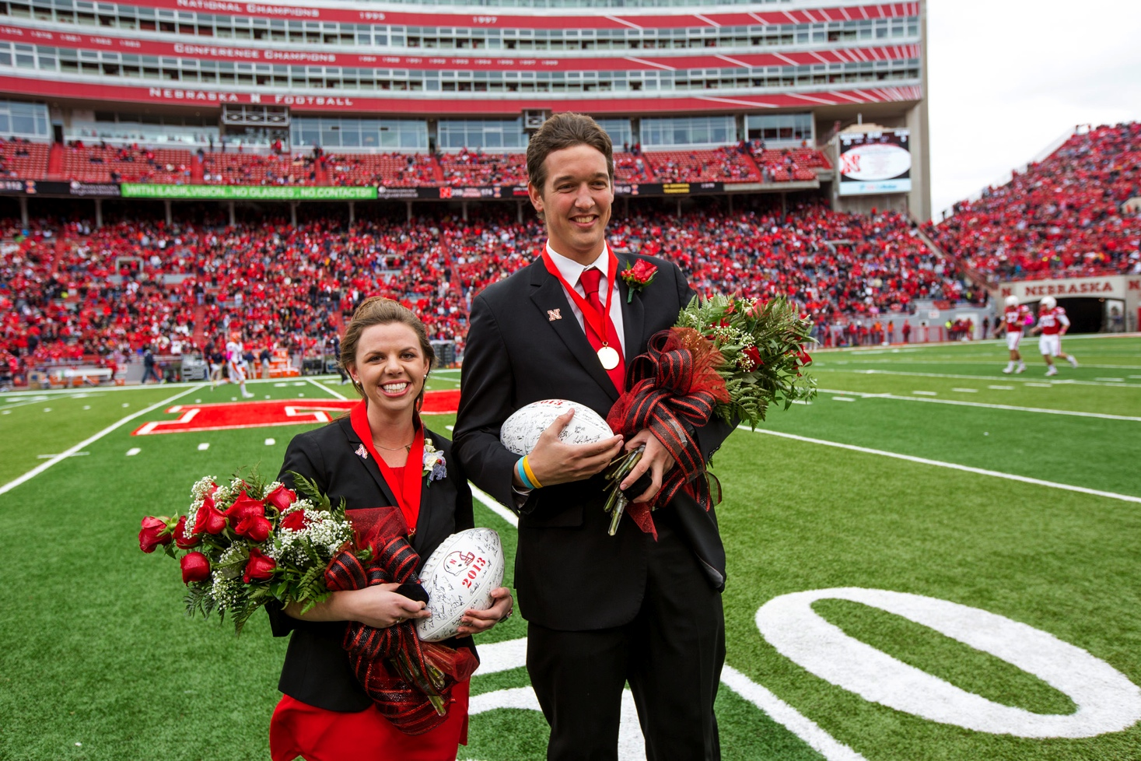

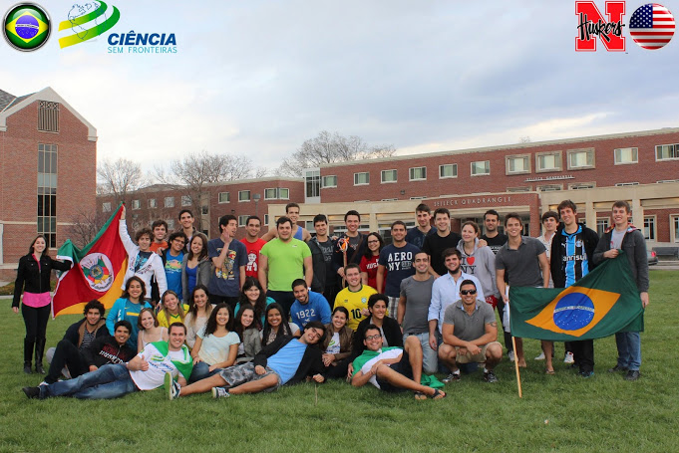
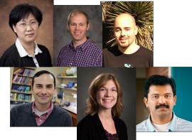
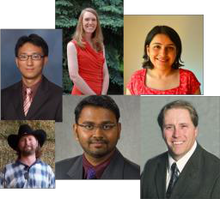
“A Year of Firsts”

Slide 7

New Curriculum and Programming Initiatives
Individualized Bachelor of Science degree program in Integrated Science
  Exploratory Studies: “deciding” students
First Bachelor of Arts degree program
Science Literacy –
  Phase I: 4 new hires
  Discipline based educational research
    Joe Dauer and Tomas Helikar, NSF grant ($2.3M) to explore simulation and dynamic systems approaches to facilitate learning
  National Center for Agricultural Literacy

Slide 8


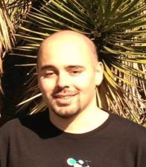

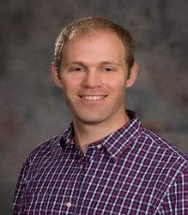
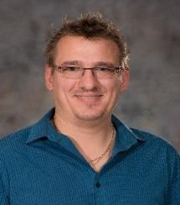
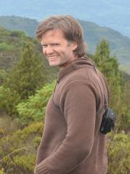
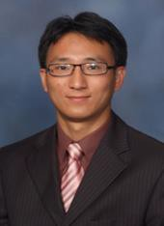
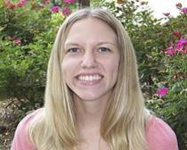

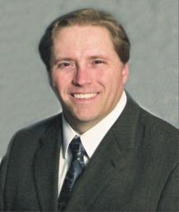
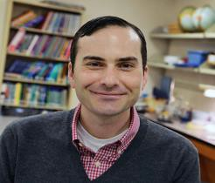

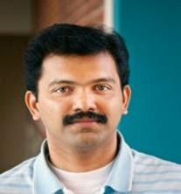
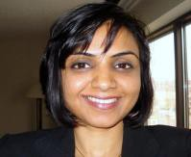
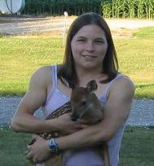
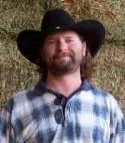
Phase I – 30+ hires
Science Literacy
Stress Biology
Healthy Systems for Ag Production & Natural Resources
Large Data Sets
Healthy Humans

Slide 9
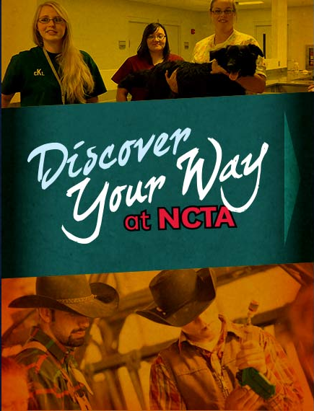

Partnerships
Life Sciences Curriculum
NCTA collaborations:
  Reverse Transfer program
  Online Applied Science Degree Completion program
  ‘Link to Lincoln’ program
Collaborative undergraduate professional degree between Environmental Studies and Master of Public Health (UNMC)
  pending approval from CCPE

Slide 10
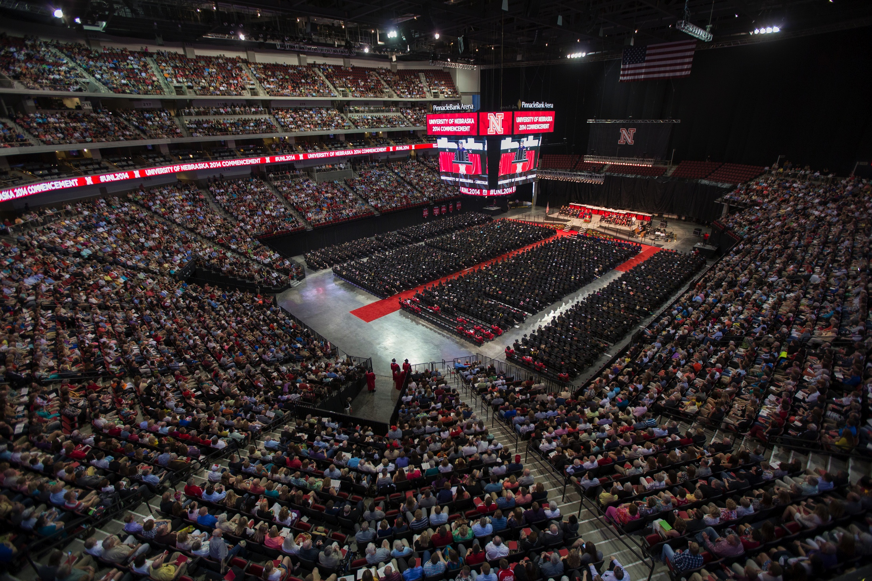
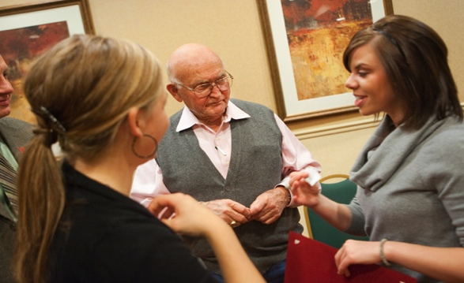
Celebrating the Success of our Students
Held the first commencement in the Pinnacle Bank Arena
Graduated our inaugural class of the Engler Agribusiness Entrepreneurship program
Homecoming King and Queen CASNR students

Slide 11

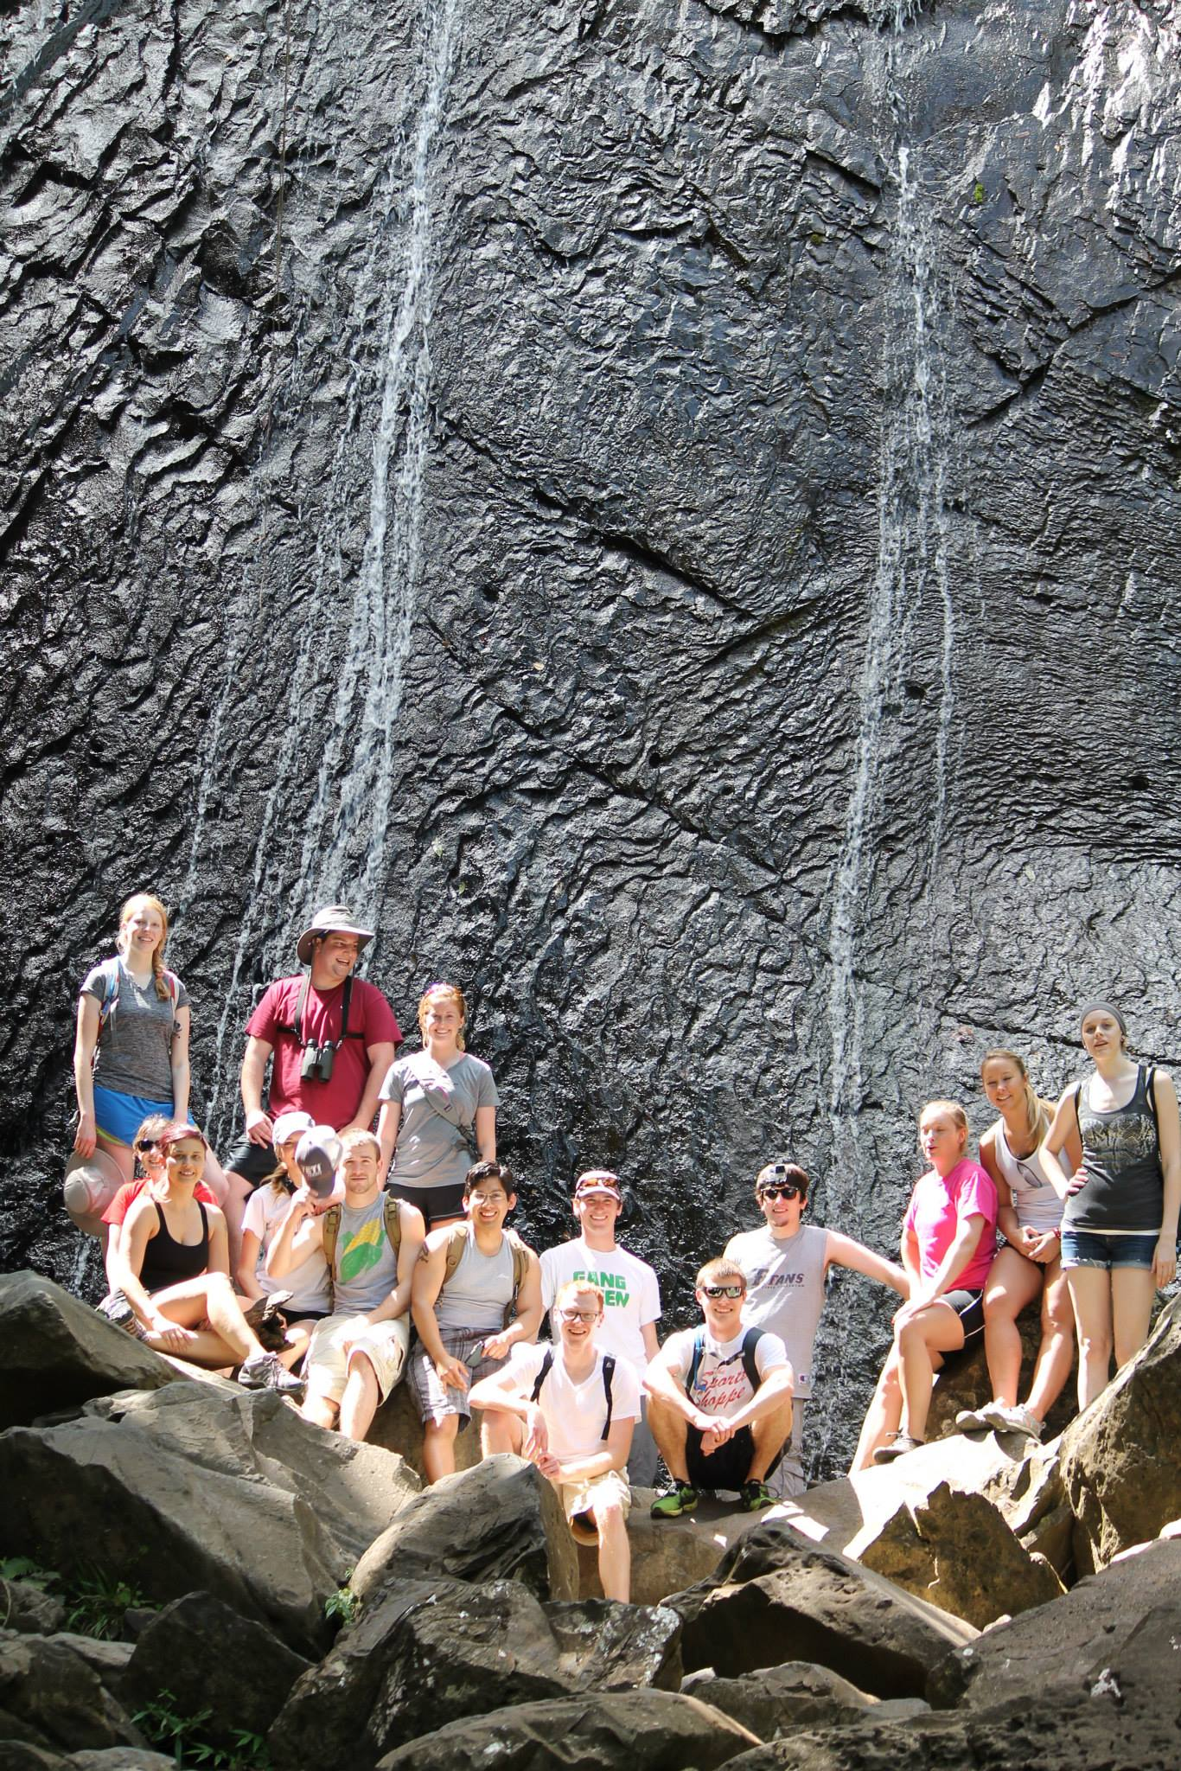
International Engagement and Education Abroad
A total of 118 CASNR students traveled internationally to 22 countries
First Education Abroad to China, Botswana, Ethiopia, and Greece
Brazil Scientific Mobility program
Undergraduate students from China enrolled in CASNR courses as part of the newly established degree completion program with Northwest Agricultural and Forestry University

Slide 12
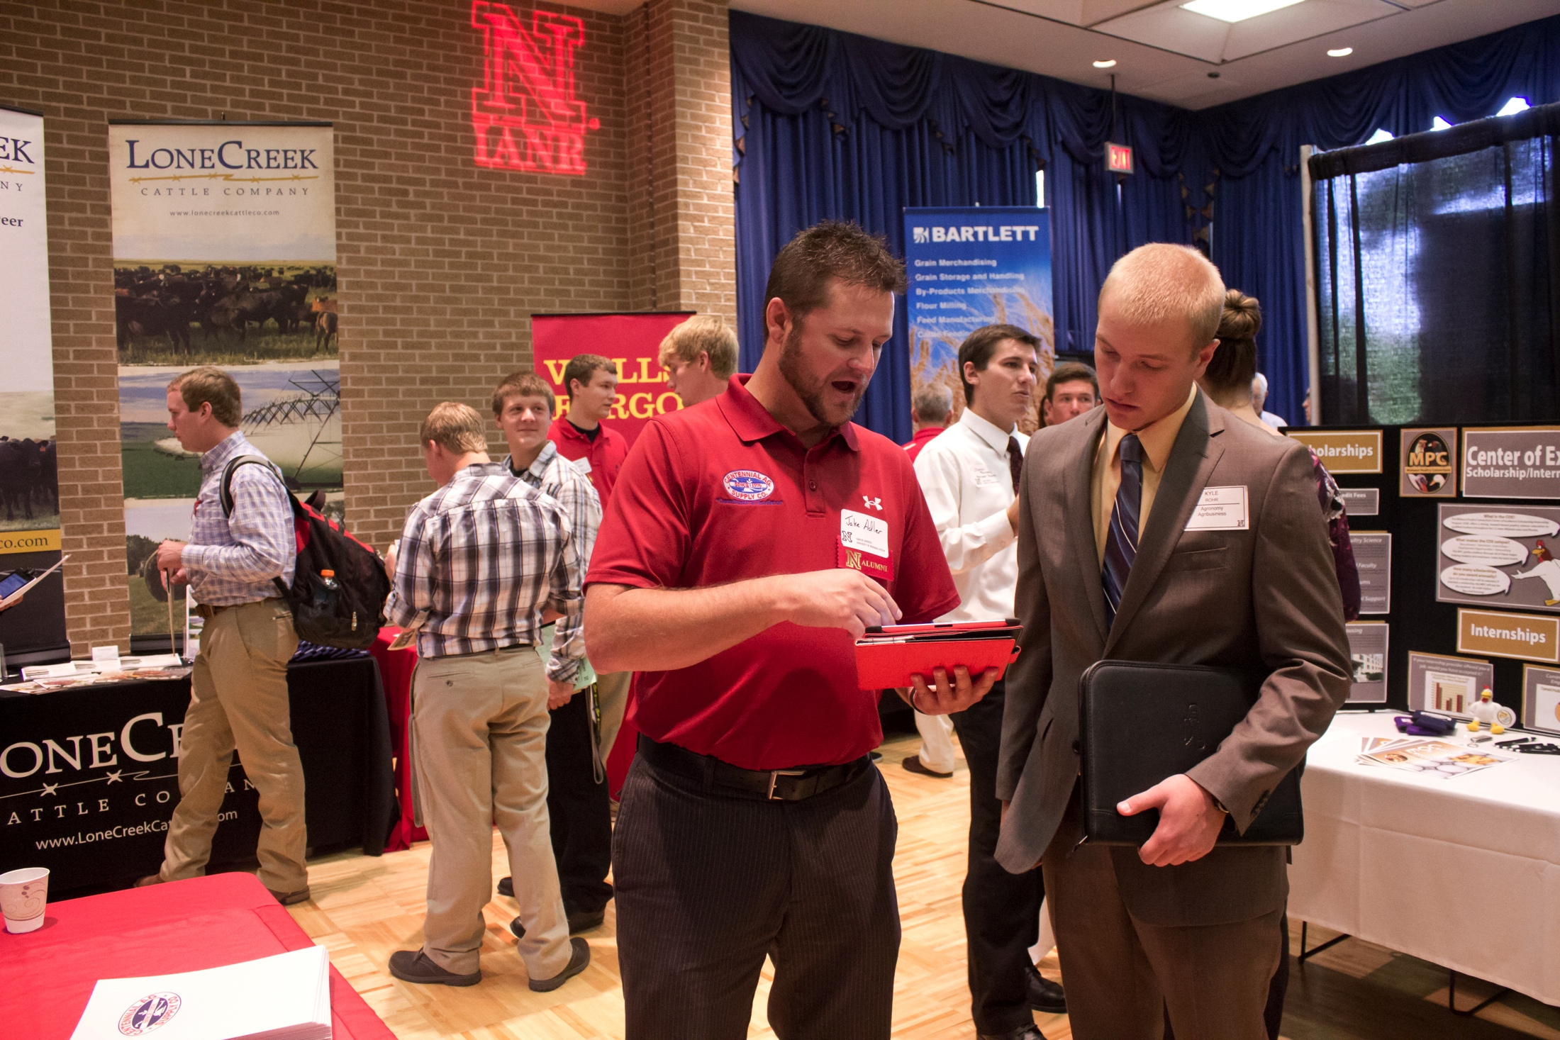
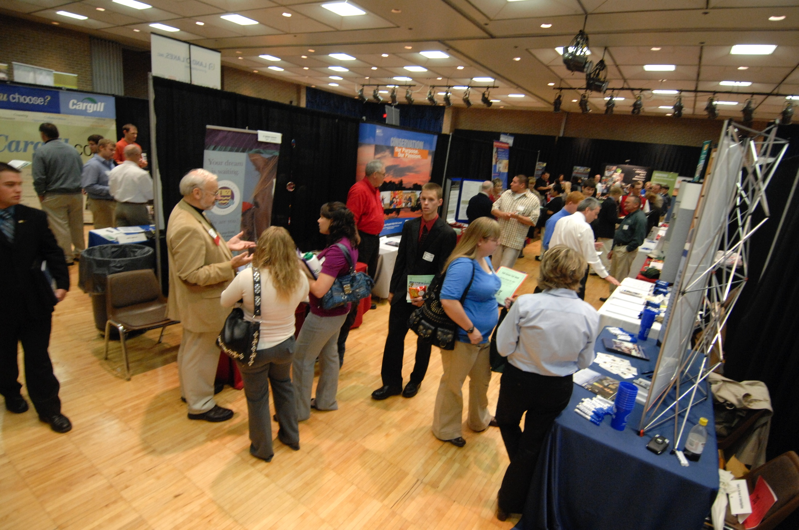
Success of Our Students
CASNR Career Fair is routinely one of the largest Career Days on campus
  Fall Attendance
    536 students
    81 employing organizations
  Spring attendance (first time)
    214 students
    50 employing organizations

Slide 13
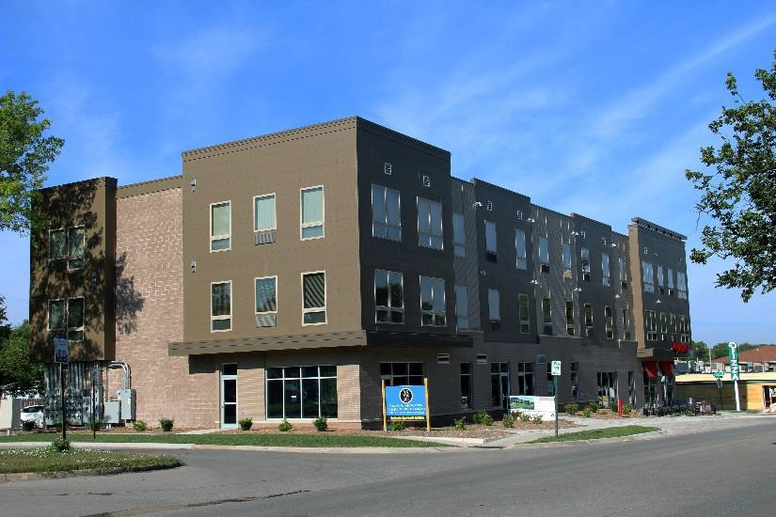
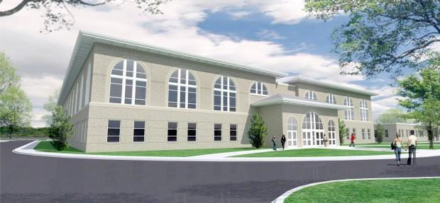
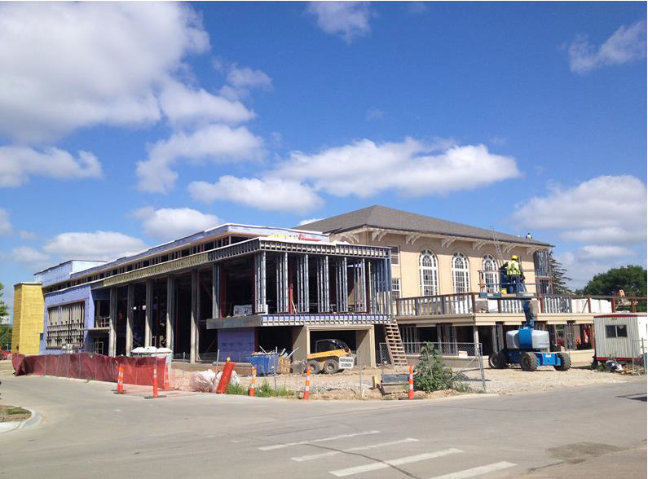
Facility Enhancement
Dedication of the new Alpha Gamma Rho house
35 East apartments and Valentino’s relocation in the new commercial space
Construction began on the new East Campus Activities Building renovation - Summer 2015
Classroom enhancements
  Commodity Trading Room
  Lecture halls

Slide 14

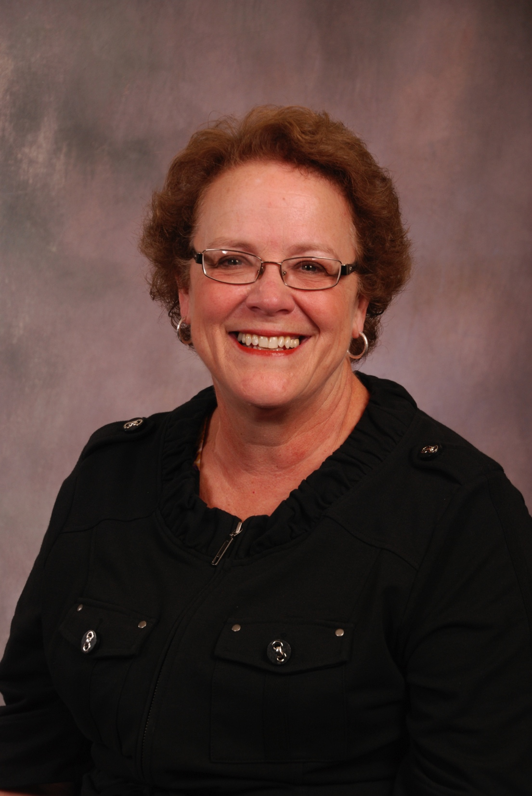
Retirements ….
Commitment to Students
A college becomes more than an organization when the faculty and staff embrace ownership, responsibility and share a common vision about serving students that transcends the years and the generations.
Dr. Jack Schinstock
Sue Voss

Slide 15
Looking to the future….
Academic year 2014-2015

Slide 16
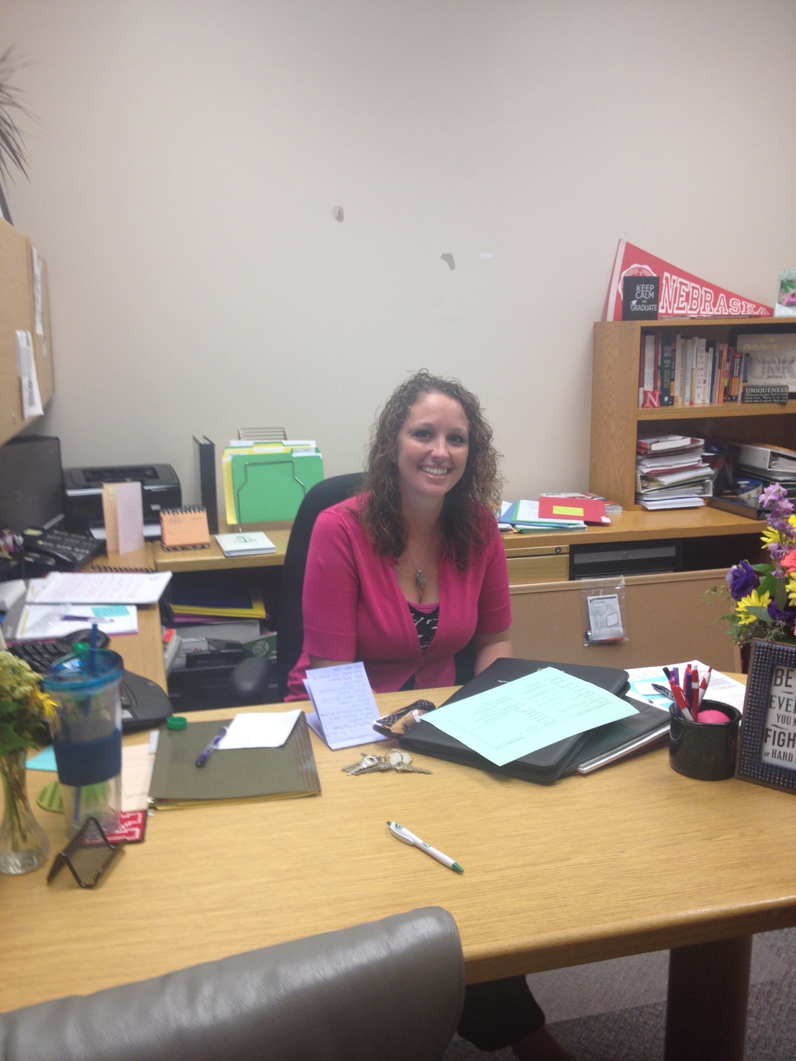
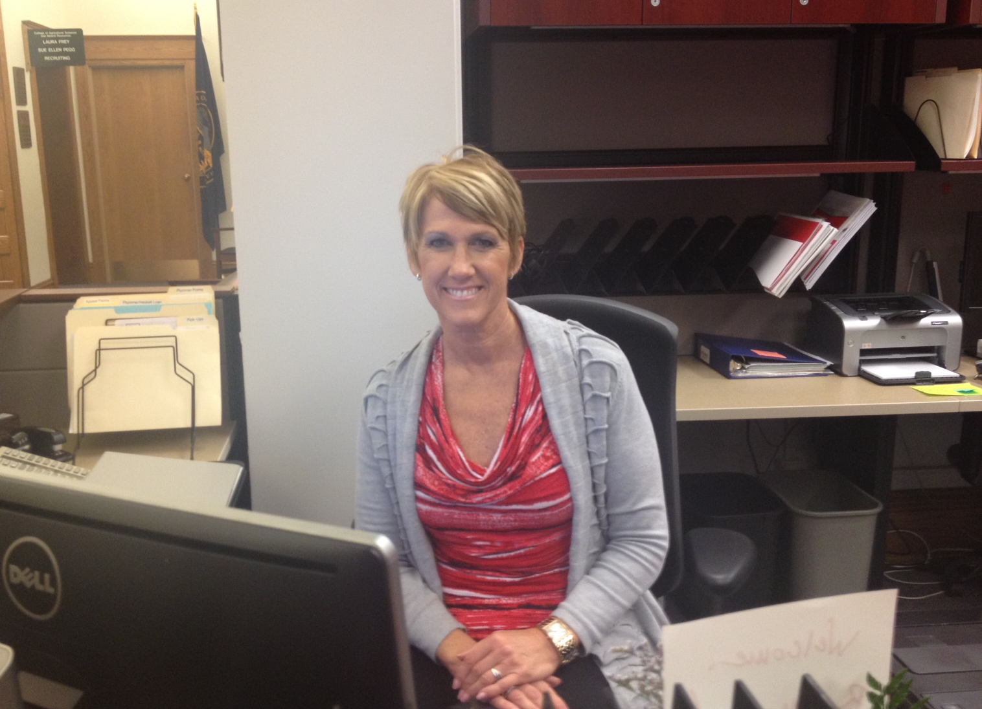

New Faces on Campus
Nicole Smith
Ramona Miller
Dean Francisco

Slide 17

Enrollment…
Predicting 10 years of growth
Possible because of the commitment among our faculty and staff to recruitment and retention

Slide 18
AGRI 103 – New Framework
Students will be able to evaluate socioscientific issues that are relevant to agriculture and natural resources using issues in Nebraska as examples.
Components of the course:
  Learning about a framework for evaluating socio-scientific arguments
  Applying the framework to socioscientific issues important to agriculture and natural resources in Nebraska
  Asking a big question about a socioscientific issue and using a scientific argument to support a position

Slide 19
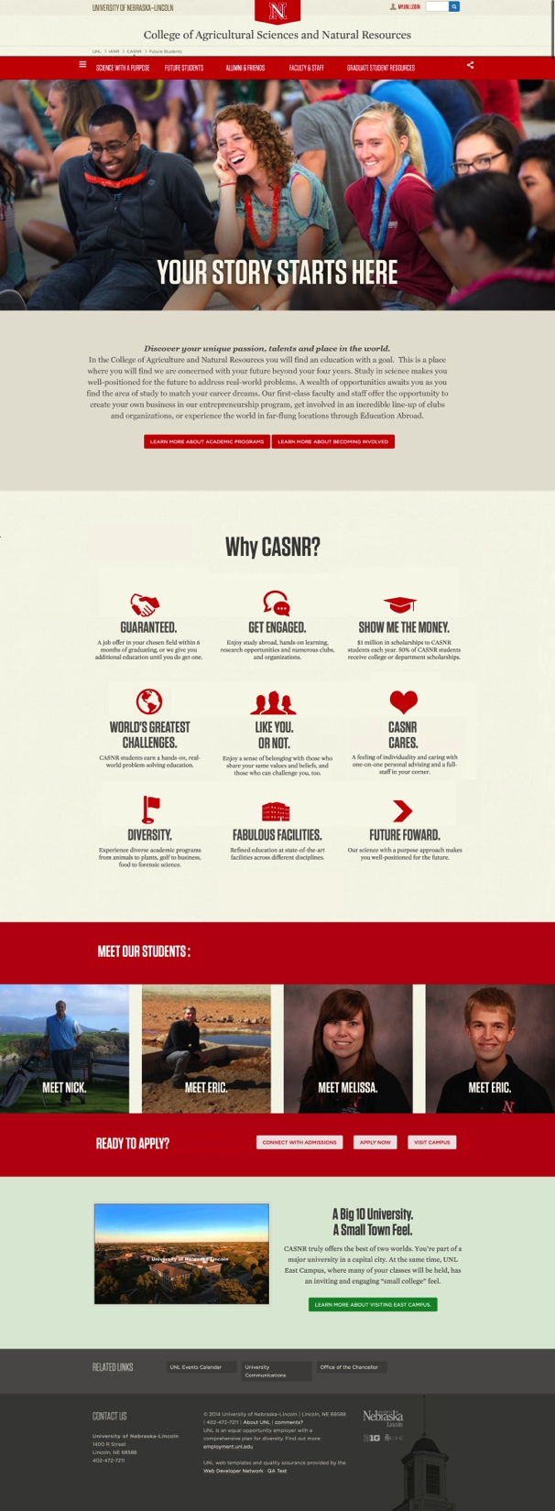

New Initiatives
Phase II – Increase tenure-track faculty by ~13%
Investment in TA support – Vice Chancellor’s commitment will continue
Online & Distance Education 2025 – plan for the future
New CASNR website
GROWING A HEALTHY FUTURE

Slide 20
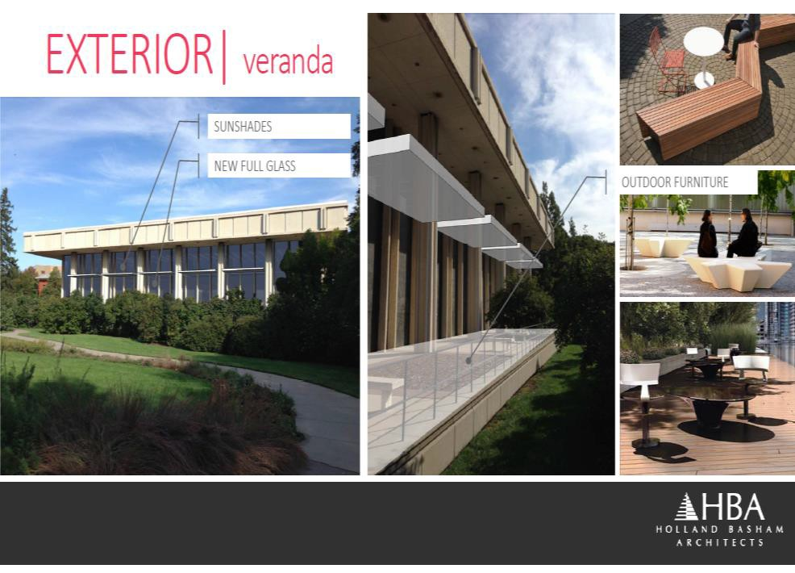
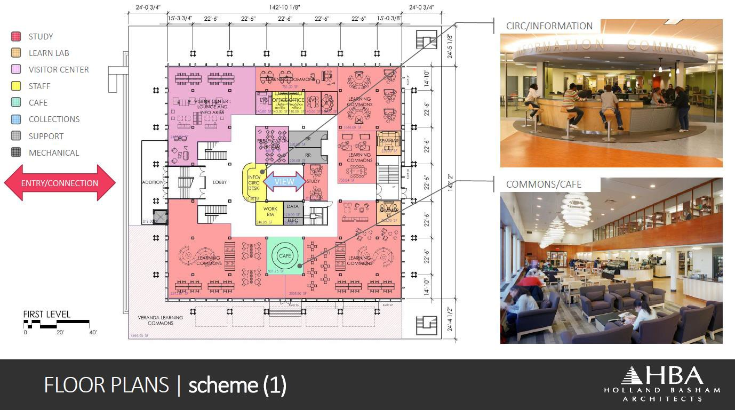
New Initiatives
CY Thompson Student Learning Commons
  BOR Vote September 2014
Planning for new residence hall
  BOR Vote November 2014

Slide 21

Upcoming Events
Luau – August 22
CASNR Welcome Back Club Fair – August 28
IANR All Hands – September 3
Football Reunion – September 27
Career Fair – October 2
Experience the Power of Red – October 18
National Science Olympiad – May 15 - 16

Slide 22
CASNR Annual Report
The annual report is dedicated to honoring those who have preceded us and built the foundation for the continued growth and service of our College. The spirit of the college is defined by the people and we are so very fortunate.
Building the future with tradition….

Slide 23
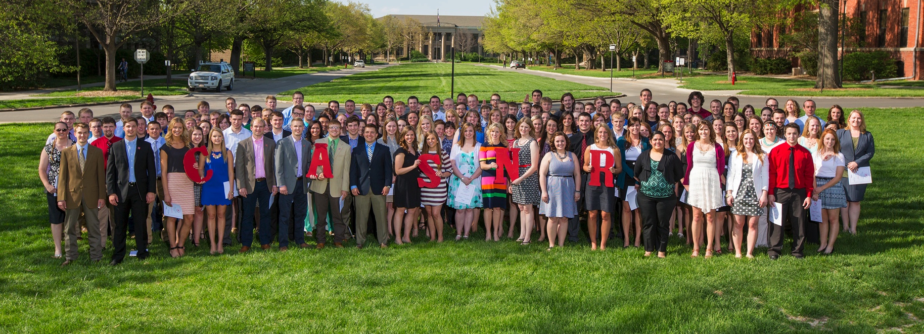
In Nebraska… Impacting the World
Thank you for your commitment and dedication to our students and the College.

