Slide 1
AGRI/NRES 103
Issues in Agriculture and Natural Resources
Jenny Dauer

Slide 2
New approach to the class
Piloted in Fall 2014
Revised pilot planned for Fall 2015

Slide 3
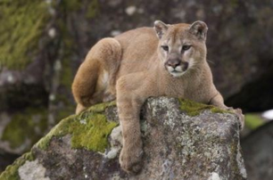
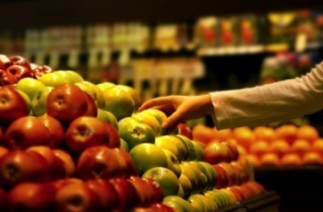
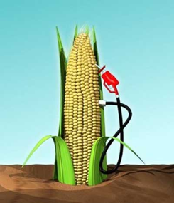
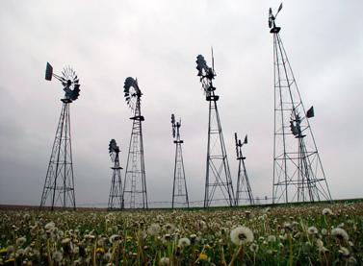
COURSE OBJECTIVE
Students will be able to evaluate socioscientific issues that are relevant to agriculture and natural resources using issues in Nebraska as examples.

Slide 4
COURSE LEARNING GOALS
As a result of the course a student will be able to:
Distinguish between questions that can be answered solely by scientific inquiry, and socioscientific questions that include both science questions and factors of values, ethics, culture, economics and politics.
Access and identify scientific information that is relevant to a socio-scientific issue and understand the personal or local implications of the scientific information for decision-making.

Slide 5
As a result of the course a student will be able to:
3. Navigate popular and science media including:
Making judgments on credibility based on professional reputation, publication venue, institutional affiliation, and potential conflicts of interest
Understanding the creation of scientific information including the peer-review process, research funding and publication, and perspectives of research organizations
Identify and evaluate claims and evidence in popular media articles

Slide 6
As a result of the course a student will be able to:
4. Explain the science and arguments from scientific evidence surrounding socioscientific issues
5. Ask a relevant question about a socioscientific issue related to agriculture and natural resources and use a scientific argument to support a position
6. Recognize and respect the diversity of opinions on each socioscientific issue, and be cognizant by what means they and others have attained their particular opinions /conclusions

Slide 7
COMPONENTS OF THE COURSE:
Learn about a framework for evaluating socio-scientific issues (2 weeks)
Apply the framework to socioscientific issues (8 weeks)
Should you eat organic or conventional food?
Should you burn biofuels?
Should we hunt mountain lions in Nebraska?
Should we further restrict the amount of water used for agriculture?
3. Ask a big question about a socioscientific issue and use a scientific argument to support a position (4 weeks)

Slide 8
2015-2016 INSTRUCTORS AND ENROLLMENT
Fall
Jenny Dauer Tu/Th 8:00-9:15
Jenny Dauer Tu/Th 9:30-9:15
Dennis Ferraro Tu/Th 2:00-3:15
Tom Powers Tu/Th 3:30-4:15
Spring
Jenny Dauer
Expected annual enrollment: 450-500 students
Other instructors: Cory Forbes
Notes:
404 in Fall Semester

Slide 9
COURSE STRUCTURE
Active learning in lecture
Each lecture has 4 graduate student learning assistants whose duties include:
Attending lecture and engaging students
Evaluating ~30 students’ coursework
Giving feedback to students on their final
Guest speakers

Slide 10

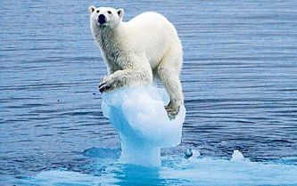
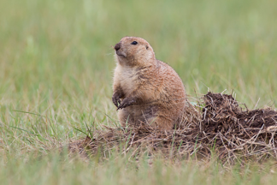
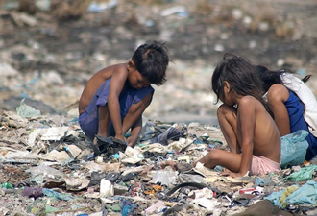
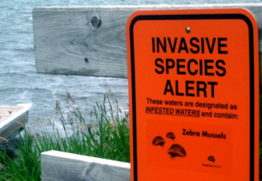

New Proposed Course Title
SCIL 101: Decision-making for a changing world

Slide 11
End of Semester Feedback
n = 250
Likert Scale averages based on:
Completely Agree Somewhat Agree Somewhat Disagree Completely Disagree
2 3 4
The instructors facilitate student learning during class periods.
Overall agree: 82%
Working in a group environment has improved my learning experience.
Overall agree: 76%
The course presents information at a level of detail where I am learning new things.
Overall agree: 69%
The course presents information that shows multiple viewpoints.
Overall agree: 79%
The lecture instructor allows me to form my own opinions.
Overall agree: 76%

Slide 12
End of Semester Feedback
n = 250
What is going well? | Total Count |  | What needs improvement? | Total Count
Working in a group/group discussions | 85 |  | Lectures are boring (or uninteresting topics to me) | 57
Learning new topics and issues, enjoy learning about important issues | 61 |  | Quizzes (too detailed, too hard, not aligned with content, shouldn't be open-note) | 30
Recitation or recitation leader | 40 |  | Needs to be taught with a different approach | 27
Unit Assignments | 30 |  | Assignments (or unit final assignments) | 24
Final Poster | 28 |  | Bias of instructors, one-sided | 17

Slide 13
SCIENCE LITERACY RESEARCH
Objectives:
1) To understand the role of science in students’ decision-making about complex issues related to agriculture and natural resources.
2) To understand how to more effectively teach students how to evaluate information and to understand how scientific information can be helpful in decision-making.
Lead: Jenny Dauer, SNR
Ashley Alred, MS student, SNR
Olivia Straka, UCARE undergrad
Jessica Thompson, undergrad
Collaborators:
Cory Forbes, SNR
Tina Vo, PhD student, SNR/TLTE
Karen Cannon, ALEC

Slide 14
SCIENCE LITERACY RESEARCH
Research questions:
How do students substantiate their opinions about what we should do about complex socioscientific issues?
How do students evaluate information they encounter in the media about complex socioscientific issues?
What teaching strategies are most effective in supporting students’ scientific thinking and use of science in decision-making?

Slide 15
SCIENCE LITERACY RESEARCH
Data collection in Fall 2014:
Students opinions about four issues and their reasons why (pre/post)
Scientific Habits of Mind Survey (pre/post)
Test of Scientific Literacy Skills (pre/post)
Student coursework including evaluation of media articles and scientific articles on four issues
43 clinical interviews of students

Slide 16
Should we eat organic or conventional foods?
Count of reasons PRE→POST
Yield is better in conventional production 17→26
No difference in health between organic and conventional 13→12
Organic is healthier 10→3
Effect on the environment 9→5
Conventional is cheaper 3→14
*Out of 40 students
Overall, counted more “reasons” 59 → 66
Notes:
Overall, we counted more “reasons” 59 to 66
cites new knowledge, more nuanced response, adds some clarity to reasoning
went from personal story about neighbor to broader overall reasoning
more articulate and more cogent in their opinion

Slide 17
Should we burn biofuels?
Count of reasons PRE→POST
Biofuels are renewable, less reliant on oil 11→7
Biofuels are better for the atmosphere 9→15
Biofuels are not better for the atmosphere 2→5
Corn and soy should be used for food 8→13
Biofuels are important for general or local economy 8→12
No reason 6→2
*Out of 40 students
Overall, counted more “reasons” 48 → 57
Notes:
Overall, we counted more “reasons” 48 to 57

Slide 18
Research to inform teaching
First years’ research primarily observational – understanding students
Based on this year’s research we are:
- asking students to find relevant information/media
- Creating more scaffolding for evaluating media
Refining our heuristic for students’ forming opinions and critically evaluating issues

Slide 19
Any questions?

Slide 21
Preliminary results – opinions pre/post
Preliminary, based on random sample of 40 out of 200 students (20%)
Olivia Straka, Karen Cannon

Slide 22
Preliminary results – Interview Analysis
43 student clinical interviews
Asked to evaluate trustworthiness and bias in ~4 articles
Ashley Alred, Tina Vo

Slide 23
Preliminary results – Interview Analysis
Students evaluate articles based on:
Language: the author’s tone, emotive language, perceived “attitude”
Evidence: completeness of data, type of evidence, misrepresentation of data
Motivation: underlying interest of the author, publisher, or funder
Social Aspects: taking note of the author’s affiliation, experience
Ashley Alred
Notes:
The three most common categories students discussed were Language, Evidence, and Motivation
Most students were able to discuss elements captured by multiple categories
Overall, students tend to provide shallow explanations of why they find an article to be trustworthy and neglect to provide specific, critical examples from the text or own knowledge to support their evaluation
Few students evaluated the background of the author, publisher, or funding sources

Slide 24
Preliminary results – Pre/post test
Scientific Habits of Mind Survey, Calik et al 2012, Calik et al 2013
Likert Scale, 23 items
Measured student attributes of:
Open-mindedness *
Skepticism
Rationality*
Objectivity*
Curiosity
*indicates significant increase pre to post
Cory Forbes

Slide 25
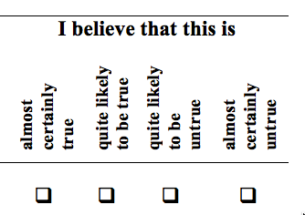
Preliminary results
Example items:
Open-mindedness - If new scientific studies produced evidence that use of fluoride in municipal water causes defects in tooth enamel, it is reasonable to consider the use of non-fluoridated water.
1 2 3 4
*Note negative scoring
Rationality- The use of colloidal silver may lead to ill-health such as kidney damage, because it contains a lot of silver ions that are deposited in our organs.

Slide 26
Preliminary results
 | MEANS (bold = sig diff P<0.001)
 | Open-mindedness | Skepticism | Rationality | Objectivity | Curiosity
Pre | 2.27 | 2.15 | 2.42 | 1.80 | 1.83
Post | 2.17 | 2.12 | 2.28 | 1.65 | 1.85
<2.5 to 1 = higher in the attribute
>2.5 to 4 = lower in the attribute

Slide 27
Preliminary results – Interview Analysis
The three most common categories students discussed were Language, Evidence, and Motivation
Most students were able to discuss elements captured by multiple categories
Overall, students tend to provide shallow explanations of why they find an article to be trustworthy and neglect to provide specific, critical examples from the text or own knowledge to support their evaluation
Few students evaluated the background of the author, publisher, or funding sources
Ashley Alred
Notes:
, in many cases three of the four categories, so this suggests that students are able to discuss trustworthiness in a variety of ways.

Slide 28
End of Semester Feedback
n = 250
Likert Scale averages based on:
Completely Agree Somewhat Agree Somewhat Disagree Completely Disagree
2 3 4
The instructors facilitate student learning during class periods.
Ave: 1.94, SD: 0.74, Overall agree: 82%
Working in a group environment has improved my learning experience.
Ave: 1.95, SD: 0.90, Overall agree: 76%
The final assignments allow me to demonstrate my learning.
Ave: 2.27, SD: 0.94, Overall agree: 68%
The in-class work improves my learning.
Ave: 2.31, SD: 0.87, Overall agree: 62%

Slide 29
End of Semester Feedback
n = 250
Likert Scale averages based on:
Completely Agree Somewhat Agree Somewhat Disagree Completely Disagree
2 3 4
The quizzes allow me to demonstrate my learning.
Ave: 2.39, SD 0.99, Overall agree: 62%
The course presents information at a level of detail where I am learning new things.
Ave: 2.20, SD 0.86, Overall agree: 69%
The course presents information that shows multiple viewpoints.
Ave: 1.94, SD 0.91, Overall agree: 79%
The lecture instructor allows me to form my own opinions.
Ave: 1.92, SD 0.94, Overall agree: 76%
The learning assistant in my recitation allows me to form my own opinions.
Ave 1.70, SD 0.87, Overall agree: 86%

Slide 30
End of Semester Feedback
n = 250
What is going well? | Total Count | What needs improvement? | Total Count
Working in a group/group discussions | 85 | Lectures are boring (or uninteresting topics to me) | 57
Learning new topics and issues, enjoy learning about important issues | 61 | Quizzes (too detailed, too hard, not aligned with content, shouldn't be open-note) | 30
Recitation or recitation leader | 40 | Needs to be taught with a different approach | 27
Unit Assignments | 30 | Assignments (or unit final assignments) | 24
Final Poster | 28 | Bias of instructors, one-sided | 17
Hearing multiple view points, getting a chance to form an opinion on a topic | 28 | Not relevant to my major | 17
Everything, it's going well | 14 | Assignments take too much time | 16
In-class discussion | 9 | More student involvement in class | 15
Instructor teaching style | 9 | Different topics* | 14
Lecture | 9 | Study guidance/information about the final project | 13
Nothing, I don't know | 8 | Groups (people who don't show up, people who have different opinions) | 12
Quizzes (and no tests) | 8 | Nothing, I don't know | 12

